Slide 1
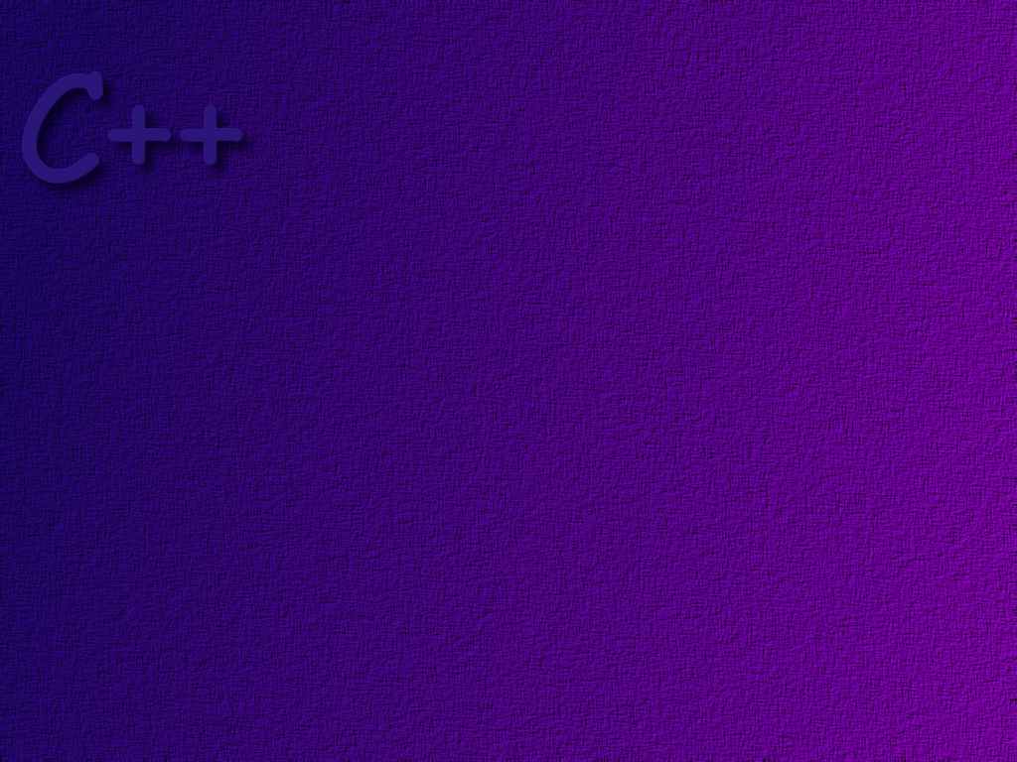
Exceptions and Program Correctness

Slide 2
Objectives
At the conclusion of this lesson, students should be able to
Explain the need for exceptions
Correctly write programs that use exceptions
Explain the rules for exception handling and exception
propogation
Use auto-pointers in a program
Use the exception function in the ios_base class to
solve input errors.

Slide 3
Motivation
Consider the following case. A programmer writes
a program, using a library function fnc( ). Function
fnc( ) encounters a situation that it cannot handle.
The function fnc( ) is capable of detecting the
situation, but does not know anything about the
program in which it was imbedded, so does not
know how to handle it.
What should the function do?

Slide 4
The function has several choices:
It can terminate the program.
This could be very bad in a program that
cannot afford to crash. It can leave the
state of the data used in the program in
a complete mess, or otherwise cause
serious harm.
Rule of thumb: Functions should not terminate the program!

Slide 5
It can return an error value.
Two problems occur with this approach.
1. The program may already return a valid
data value, and a valid value does not
exist to signal an error.
2. If an error code is returned, then the
checking of return values at all levels
of the program becomes very tedious.
This is common behavior in C programs, where there is no
built-in exception handling. It can create “spaghetti” code.

Slide 6
It can return some value, but leave the
program in an error state.
This may be the worst situation, since the
user does not know that an error occurred.
Meanwhile, the program has done something
wrong and no one knows.

Slide 7
The C++ exception mechanism is meant to handle
exceptional situations … that is, situations where
some part of the program could not do what it was
supposed to do.
The important idea in C++ exception handling is that
the code that discovers the exception condition is not
(necessarily) responsible for handling the exception.
It can push the exception up the through the sequence
of callers until it reaches a point where there is
sufficient information about the context in which the
program is running to resolve the problem.

Slide 8
Example
main ( )
start a dialogue with end user
* get some data
* get a file name
call a function to do
some calculations
with the data
This function, if it knew that
the filename was wrong,
could ask the user for a
different name.
user interface
code
open a file and
save the result
of the calculations
calculation
code
This function knows
nothing about files
or filenames
file
manager
code
This function does
not know that any
calculations were
done or where the
file name came from.

Slide 9
Example

Slide 10

this function knows
nothing about where
the data it is working
on came from, so it
is unable to do any
error recovery.
If d happens to be zero, a
divide by zero exception is
raised. Since there is no code
to handle the exception, the
program terminates.
double divide (int n, int d)
{
return static_cast<double>(n)/d;
}
int main ( )
{
int num1, num2;
double quotient;
do
{
cout << “\nEnter in two integers:”;
cin >> num1 >> num2;
cout << num1 << “/” << num2 << “ = “
<< divide (num1, num2);
} while (num1 != 0);
}

Slide 11
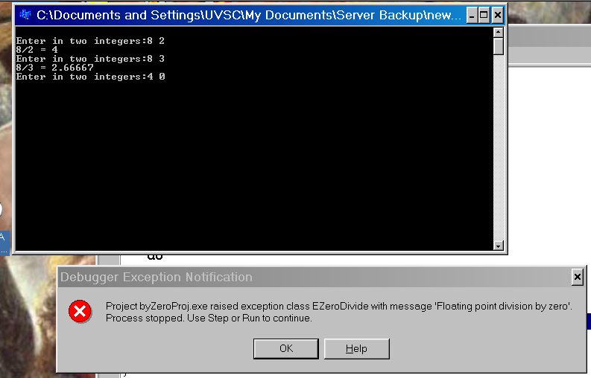

Slide 12
We will do several things to fix this problem.
1. We will create an exception class and then use an
object of that class to hold information about the error
that occurred.
2. We will put a test in the divide( ) function to test the
denominator. If it is zero, we will throw an exception.
3. In main( ), we will put the call to the divide( ) function
in a try block.
4. We will write a catch block in main( ) to handle the
exception.

Slide 13
The constructor just
initializes the char array.
The exception class
class DivideByZeroException
{
public:
DivideByZeroException ( )
: message (“Zero denominator … try again”)
{ }
const char* what ( ) const { return message; }
private:
const char* message;
};
we also provide a function to
retrieve the error message.
The main purpose of an exception
class is to create objects to hold
information about the error that
occurred. In this case we will simply
store a char array, message.

Slide 14
double divide (int n, int d)
{
if (d == 0)
throw DivideByZeroException( );
return static_cast<double>(n)/d;
}
Note that you can thrown any
data type … for example, you
could throw an integer.
this statement says …
if the denominator is zero, we’ll get a hardware
exception. Inside the function, we don’t have enough
context to solve the problem, so create an
object of the DivideByZeroException class,
and pass it back to the calling function. When an
exception is thrown, execution of the function
stops immediately and control returns to the
calling point with the exception on the stack.

Slide 15
int main ( )
{
int num1, num2;
double quotient;
do
{
cout << “\nEnter in two integers:”;
cin >> num1 >> num2;
try
{
quotient = divide (num1, num2);
cout << num1 << “/” << num2 << “ = “
<< quotient;
}
catch ( DivideByZeroException e)
{
cout << e.what( );
}
} while (num1 != 0);
}
Place any code where you expect that
an exception may occur inside of a try
block. Also include in the try block any
statements you want skipped, should
an exception occur.
If no exception occurs,
control proceeds to the
first statement after the
catch block.

Slide 16
int main ( )
{
int num1, num2;
double quotient;
do
{
cout << “\nEnter in two integers:”;
cin >> num1 >> num2;
try
{
quotient = divide (num1, num2);
cout << num1 << “/” << num2 << “ = “
<< quotient;
}
catch ( DivideByZeroException& e)
{
cout << e.what( );
}
} while (num1 != 0);
}
The catch block immediately
follows the try block. If an
exception of the type given as
a parameter is received by the
calling function, then this catch
block is executed. Otherwise,
it is not.
Control always goes to the
statement after the catch block.

Slide 17
int main ( )
{
int num1, num2;
double quotient;
do
{
cout << “\nEnter in two integers:”;
cin >> num1 >> num2;
try
{
quotient = divide (num1, num2);
cout << num1 << “/” << num2 << “ = “
<< quotient;
}
catch ( DivideByZeroException& e)
{
cout << e.what( );
}
} while (num1 != 0);
}
num1
num2
runtime
stack
double divide (int n, int d)
{
if (d == 0)
throw DivideByZeroException( );
return static_cast<double>(n)/d;
}

Slide 18
int main ( )
{
int num1, num2;
double quotient;
do
{
cout << “\nEnter in two integers:”;
cin >> num1 >> num2;
try
{
quotient = divide (num1, num2);
cout << num1 << “/” << num2 << “ = “
<< quotient;
}
catch ( DivideByZeroException& e)
{
cout << e.what( );
}
} while (num1 != 0);
}
6
num1
0
num2
runtime
stack
double divide (int n, int d)
{
if (d == 0)
throw DivideByZeroException( );
return static_cast<double>(n)/d;
}

Slide 19
int main ( )
{
int num1, num2;
double quotient;
do
{
cout << “\nEnter in two integers:”;
cin >> num1 >> num2;
try
{
quotient = divide (num1, num2);
cout << num1 << “/” << num2 << “ = “
<< quotient;
}
catch ( DivideByZeroException& e)
{
cout << e.what( );
}
} while (num1 != 0);
}
6
num1
0
num2
runtime
stack
double divide (int n, int d)
{
if (d == 0)
throw DivideByZeroException( );
return static_cast<double>(n)/d;
}

Slide 20
int main ( )
{
int num1, num2;
double quotient;
do
{
cout << “\nEnter in two integers:”;
cin >> num1 >> num2;
try
{
quotient = divide (num1, num2);
cout << num1 << “/” << num2 << “ = “
<< quotient;
}
catch ( DivideByZeroException& e)
{
cout << e.what( );
}
} while (num1 != 0);
}
6
num1
0
num2
0
6
rtn address
runtime
stack
double divide (int n, int d)
{
if (d == 0)
throw DivideByZeroException( );
return static_cast<double>(n)/d;
}

Slide 21
int main ( )
{
int num1, num2;
double quotient;
do
{
cout << “\nEnter in two integers:”;
cin >> num1 >> num2;
try
{
quotient = divide (num1, num2);
cout << num1 << “/” << num2 << “ = “
<< quotient;
}
catch ( DivideByZeroException& e)
{
cout << e.what( );
}
} while (num1 != 0);
}
6
num1
0
num2
0
d
6
n
rtn address
runtime
stack
double divide (int n, int d)
{
if (d == 0)
throw DivideByZeroException( );
return static_cast<double>(n)/d;
}

Slide 22
int main ( )
{
int num1, num2;
double quotient;
do
{
cout << “\nEnter in two integers:”;
cin >> num1 >> num2;
try
{
quotient = divide (num1, num2);
cout << num1 << “/” << num2 << “ = “
<< quotient;
}
catch ( DivideByZeroException& e)
{
cout << e.what( );
}
} while (num1 != 0);
}
6
num1
0
num2
0
d
6
n
rtn address
runtime
stack
double divide (int n, int d)
{
if (d == 0)
throw DivideByZeroException( );
return static_cast<double>(n)/d;
}

Slide 23
int main ( )
{
int num1, num2;
double quotient;
do
{
cout << “\nEnter in two integers:”;
cin >> num1 >> num2;
try
{
quotient = divide (num1, num2);
cout << num1 << “/” << num2 << “ = “
<< quotient;
}
catch ( DivideByZeroException& e)
{
cout << e.what( );
}
} while (num1 != 0);
}
6
num1
0
num2
DivideByZero
Exception
object
runtime
stack
double divide (int n, int d)
{
if (d == 0)
throw DivideByZeroException( );
return static_cast<double>(n)/d;
}
this statement does not get executed!

Slide 24
int main ( )
{
int num1, num2;
double quotient;
do
{
cout << “\nEnter in two integers:”;
cin >> num1 >> num2;
try
{
quotient = divide (num1, num2);
cout << num1 << “/” << num2 << “ = “
<< quotient;
}
catch ( DivideByZeroException& e)
{
cout << e.what( );
}
} while (num1 != 0);
}
6
num1
0
num2
DivideByZero
Exception
object
runtime
stack
double divide (int n, int d)
{
if (d == 0)
throw DivideByZeroException( );
return static_cast<double>(n)/d;
}

Slide 25
int main ( )
{
int num1, num2;
double quotient;
do
{
cout << “\nEnter in two integers:”;
cin >> num1 >> num2;
try
{
quotient = divide (num1, num2);
cout << num1 << “/” << num2 << “ = “
<< quotient;
}
catch ( DivideByZeroException& e)
{
cout << e.what( );
}
} while (num1 != 0);
}
6
num1
0
num2
runtime
stack
double divide (int n, int d)
{
if (d == 0)
throw DivideByZeroException( );
return static_cast<double>(n)/d;
}

Slide 26
int main ( )
{
int num1, num2;
double quotient;
do
{
cout << “\nEnter in two integers:”;
cin >> num1 >> num2;
try
{
quotient = divide (num1, num2);
cout << num1 << “/” << num2 << “ = “
<< quotient;
}
catch ( DivideByZeroException& e)
{
cout << e.what( );
}
} while (num1 != 0);
}
6
num1
0
num2
runtime
stack
double divide (int n, int d)
{
if (d == 0)
throw DivideByZeroException( );
return static_cast<double>(n)/d;
}

Slide 27
Multiple Exceptions
When a function executes, it may be possible
that more than one kind of an exception may
occur. C++ provides a mechanism for the
calling function to figure out which exception
occurred.

Slide 28
For demonstration purposes, suppose
that dividing by a negative number is
also an exception condition. We could
then catch both divide by zero and
divide by negative number by using
two catch blocks as shown.
try
{
quotient = divide (num1, num2);
cout << num1 << “/” << num2 << “ = “
<< quotient;
}
catch (DivideByZeroException& e)
{
cout << e.what( );
}
catch (DivideByNegativeException& e)
{
cout << “tried to divide by a negative number\n”;
}
} while (num1 != 0);
}
The system will look for the
first catch block that matches
the type thrown.
control always resumes here.

Slide 29
try
{
quotient = divide (num1, num2);
cout << num1 << “/” << num2 << “ = “
<< quotient;
}
catch (DivideByZeroException& e)
{
cout << “Tried to divide by zero\n”;
}
catch (DivideByNegativeException& e)
{
cout << “Tried to divide by a negative number\n”;
}
catch (…)
{
cout << ”Something else happened\n”;
}
} while (num1 != 0);
}
The default catch
(…) catches anything.

Slide 30
Catch Rules
The catch block that is executed is the first catch block
following the currently active try block, whose parameter
matches the type thrown.
The default catch
catch (…)
will catch any exception type thrown.
If no match is found, the program is terminated.

Slide 31
When looking for a match, no conversions are done,
except for derived class to base class conversions. Thus,
a match occurs if
- The catch parameter type exactly matches that thrown
- The catch parameter type is a public base class of the
type thrown
- The default catch is used.

Slide 32

Poorly Ordered Catches
Let the exception class EmployeeException have two
derived classes, FullTimeException and
PartTimeException.
Employee
Exception
FullTime
Exception
PartTime
Exception

Slide 33
… then what is wrong with the following:
catch (EmployeeException& e)
{
…
}
catch (FullTimeException& e)
{
…
}
catch (PartTimeException& e)
{
…
}
since this catch parameter
is the base class for both
FullTimeException and
PartTimeException, this
catch block will be executed
no matter which of these 3
exception types is thrown.
… and these exception blocks will never
be executed, no matter what the error is.

Slide 34
Re-throwing an exception
Suppose that a function catches an exception, but the
catch block cannot completely handle the error. It can
re-throw the exception, causing it to flow to the code
that called this function.
throw;
note that the throw
statement has no
parameters
in this case.

Slide 35
Exception Propagation
Sometimes called stack unwinding, exception propagation
works as follows:
If an exception is not handled where it occurs,
All of the local variables in the called function are destroyed
The function immediately exits and the uncaught exception
is raised in (passed to) the calling function.
Control returns to the point where the call was made
If the call was inside of a try block, an attempt is made to
catch the exception
- If a matching catch block is found, it is executed
- If no match is found, control passes to the calling
function, using this same mechanism.
If the calling code is not inside of a try block, control passes
to the calling function, using this same mechanism.

Slide 36
int main ( )
{
try
{
function1 ( );
cout << “\nIt worked!!”;
}
catch
{
cout << “\nException … didn’t work!”;
}
cout << “\nHit a key to exit…”;
getch ( );
return 0;
}

Slide 37
void function1 ( ) throw ( runtime_error )
{
cout << “\nStarting function 1 … hit a key”;
getch ( );
cout << “\nCalling function2 “;
function2 ( );
cout << “won’t see this message!”;
}

Slide 38
void function2 ( ) throw ( runtime_error )
{
cout << “\nStarting function 2 … hit a key”;
getch ( );
cout << “\nCalling function3 “;
function3 ( );
cout << “won’t see this message!”;
}

Slide 39
void function3 ( ) throw ( runtime_error )
{
cout << “\nStarting function 3 … press a key”;
getch ( );
cout << “\nThrowing an exception”;
throw runtime_error (“did it in function 3” );
}

Slide 40
Stack
main ( ) {
try {
function1( );
}
catch { }
. . .
void function1 ( ) {
function2 ( )
…
rtn address2
rtn address1
exception
rtn addressm
void function2 ( ) {
function3 ( )
…
Now find the right catch block!
exception
void function3 ( ) {
throw runtime_error;
. . .
exception

Slide 41
Testing For Available Memory
The new operator throws a bad_alloc exception if there
is not enough memory to satisfy the request. So, you can
check for these errors with code like …
try
{
nodePtr = new Node( );
}
catch (bad_alloc&)
{
…
}
#include <new>
using std::bad_alloc;

Slide 42
The auto_ptr Class
As we have seen, it is common to create an
object on the heap, storing the address of the
object in a pointer. When we are done with the
object, we can free the storage using the delete
operator.
If an exception occurs after the storage has been
allocated, but before the delete is executed, a
memory leak may occur.

Slide 43
auto_ptr is a class template provided in C++
to help solve this problem.
An object of the auto_ptr class maintains a
pointer to dynamically allocated storage.
The auto_ptr class provides * and -> operators,
so it works like a normal pointer variable.
However, it has the property that when the
auto_ptr object goes out of scope, it performs
a delete on the storage it points to.

Slide 44
Example
#include <iostream>
using std::endl;
using std::cout;
#include <memory>
using std::auto_ptr;
auto_ptr is defined in the
header file <memory>

Slide 45
class Integer
{
public:
Integer (int i = 0) : value (i)
{
cout << “Constructor for Integer “ << value << endl;
}
~Integer ( )
{
cout << “Destructor for Integer “ << value << endl;
}
void setInteger (int i) { value = i; }
int getInteger ( ) { return value; }
private:
int value;
};
print out messages so we know
when constructors and destructors
are executed.

Slide 46
int main( )
{
cout << “Creating an auto-ptr object that points to an Integer\n”;
auto_ptr<Integer> ptrToInteger (new Integer (7) );
cout << “Use the auto_ptr to manipulate the Integer\n”;
ptrToInteger->setInteger (99);
cout << “Integer after setInteger: “
<< (*ptrToInteger).getInteger( );
<< “\nTerminating program …” << endl;
return 0;
}

Slide 47
Using the exceptions Function in the ios Class
We have noted that stream operations do not throw
exceptions. In the past, we tested the state of the
stream after any I/O operation to see whether or not
the operation worked.
Now that we have learned about exceptions, we can
take a different approach.

Slide 48
The ios_base class, from which all stream classes
are inherited, provides the exceptions( ) function.
Using the exceptions( ) function, we can tell the
stream to throw exceptions when an error occurs.
Then we use standard exception handling to process
these errors.

Slide 49
int main( )
{
cin.exceptions (ios_base::badbit | ios::failbit);
int n;
do
{
try
{
cout << “Enter an integer (0 to quit): “;
cin >> n;
cout << “You typed “ << n << endl;
}
catch (ios_base::failure& e)
{
cin.clear ( );
cin.ignore (80, ‘\n’);
cout << “You typed an invalid integer\n”;
}
} while ( n != 0);
return 0;
}
when either the badbit or the
failbit is set, the stream throws
an exception.
when we catch the error,
we clear the rdstate byte
and clean the buffer.

Slide 50
The Hierarchy of Standard Exception Types in C++
Where possible, you should re-use exception classes from the standard library. You can also use inheritance to define your own exceptions as more specialized versions of these built-in exception classes.
#include <stdexcept>

Slide 51

exception
bad_alloc
logic_error
runtime_error
bad_cast
length_error
range_error
Violations of
a post-condition
Violations of
a pre-condition
domain_error
overflow_error
out_of_range
underflow_error
invalid_argument
un-recoverable

Slide 52
For example …
double someFunction( … )
{
…
throw logic_error(“Invalid code”);
}

Slide 53
Exceptions & Constructors
An object is not considered to be constructed until the constructor is completely executed.
An exception thrown inside a constructor will not cause the destructor to be executed. This could result in a memory leak.

Slide 54
class DataArray
{
public:
DataArray(int);
~DataArray( );
void init(int);
private:
int* data;
};
DataArray::DataArray(int s)
{
data = new int[s];
init(s);
}
What happens if an exception
occurs here?

Slide 55
DataArray::DataArray(int s)
{
data = new int[s];
try
{
init(s);
}
catch (…)
{
delete[ ] data;
data = NULL;
throw;
}
}

Slide 56
The Bridge Pattern
Also known as the Handle/Body pattern, the bridge
pattern provides a way for the programmer to
completely hide the details of an implementation.

Slide 57
C++ provides encapsulation and data abstraction by
using the private keyword to hide the details of a
class’s implementation.
However, the private keyword only prevents access to
the class’s private elements, it does not really hide them.
A programmer only need look at the class’s header file
to glean a great deal of information about how a class
is implemented.
What if you really want to hide the details? For example,
what if you have a proprietary algorithm you don’t want
users of your class to know about.

Slide 58
Example
The Impl class contains the actual
implementation details. The pointer
_theImpl is used to pass a request on
to an object of the Impl class.
For example, in the Handle class, the
foo( ) function might be written as
void Handle::foo ( )
{
_theImpl -> foo( );
}
class Handle
{
public:
Handle ( );
~Handle( );
void foo ( );
private:
Impl* _theImpl;
};

Slide 59

A good paper on the Bridge design pattern
can be found here:

